Slide 1
Monster Assault
Mayank K Rastogi (1005083)
Arshya Pany (1005032)
Shilpi Kumari (1005274)

Slide 2
What is Monster Assault?
Monster Assault is a 2D-platformer android and desktop game written in JAVA.
It is a simple game where the user is required to move the character 'Bob' using arrow keys or the on-screen touchpad.
Bob can jump and fire to dodge hurdles and kill monsters which gain him points.
Completing one level takes him to the next.

Slide 3
Purpose
Develop an android game that will entertain and hook everyone.
Make an achievement for the developers
Enhance knowledge and skills
Inspired by playing games in different hand held devices
Choose android for the reason that is trending
To develop an open-ended game application

Slide 4
Why Monster Assault as an Android app?
Android is an open-source platform developed under the Open Handset Alliance to enable faster development of mobile applications and provision of services to the user.
The Google Android operating system is growing more and more popular with each passing month and there are wide range of Android smart phones now available.
A large potential audience for Android games and a genuine hunger for some quality releases in the Android Play Store make Android game development a very attractive prospect.

Slide 5
TECHNOLOGIES USED

Slide 6




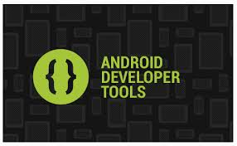

Technologies Used

Slide 7
Java
Java is an object oriented computer programming language
Java applications are typically compiled to bytecode (class file) that can run on any Java virtual machine (JVM) regardless of computer architecture
Java is one of the most popular programming languages

Slide 8
Android
Android is a Linux-based operating system designed primarily for touchscreen mobile devices such as smartphones and tablet computers.
Android is open source and Google releases the code under the Apache License.
Android applications are written in java programming language.
Android is available to develop applications which can be further used for selling in android play store.

Slide 9
Eclipse is a multi-language Integrated development environment (IDE) comprising a base workspace and an extensible plug-in system for customizing the environment. It is written mostly in Java.

Slide 10
Android Developer Tools
The Android Developer Tools (ADT) plugin for Eclipse provides a professional-grade development environment for building Android apps. It's a full Java IDE with advanced features to help you build, test, debug, and package your Android apps.

Slide 11
Libgdx
Libgdx is a cross-platform game and visualization development framework. It currently supports Windows, Linux, Mac OS X, Android, iOS and HTML5 as target platforms.
Libgdx allows you to write your code once and deploy it to multiple platforms without modification.
It offers a powerful set of APIs that help you with common game development tasks like rendering sprites & text, building user interfaces, playing back sound effects and music streams, linear algebra and trigonometry calculations and so on.

Slide 12
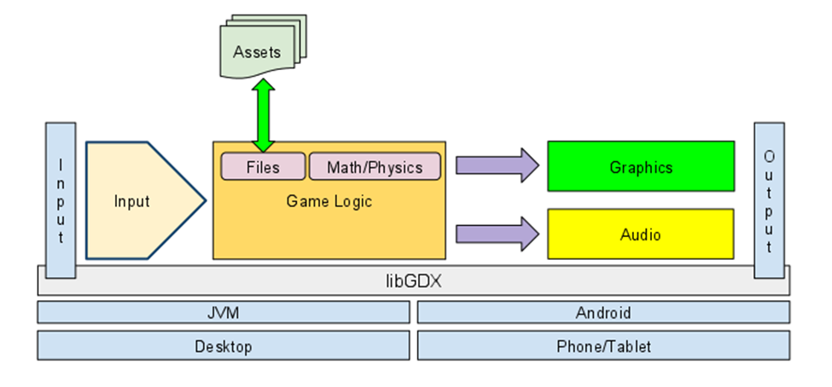

Slide 13

Cross-language, multi-platform application programming interface (API) for rendering 2D and 3D computer graphics
It is designed for embedded systems like smartphones, computer tablets, video game consoles and PDAs.
The API is cross-language and multi-platform

Slide 14
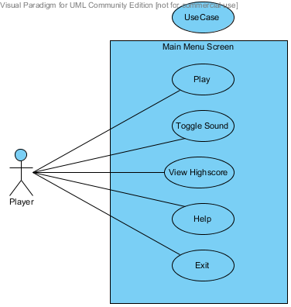
Use Case Model

Slide 15
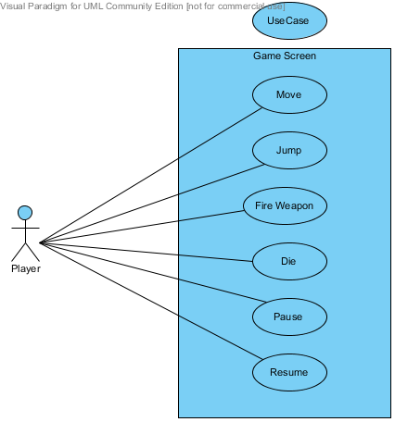
Use Case Model

Slide 16
MVC Architecture
The architecture pattern we used in game development is the MVC (model-view-controller) pattern.
The main aim of the MVC architecture is to separate the business logic and application data from the presentation data to the user.

Slide 17
MODEL
VIEW
CONTROLLER

Slide 18
GAMEPLAY

Slide 19
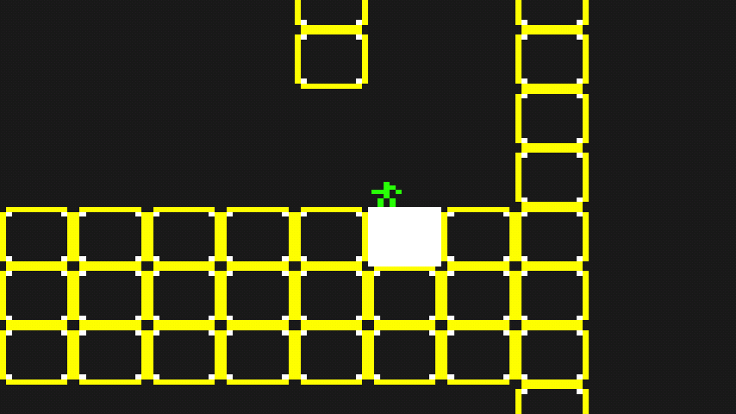
Sample Screenshots
Bob idle – facing left

Slide 20
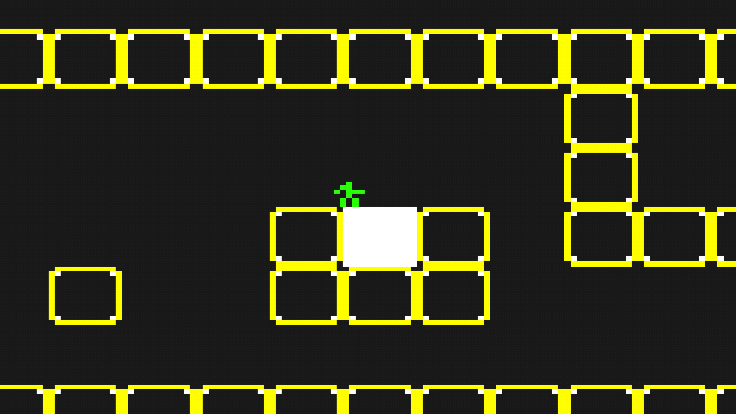
Sample Screenshots
Bob idle - facing right

Slide 21
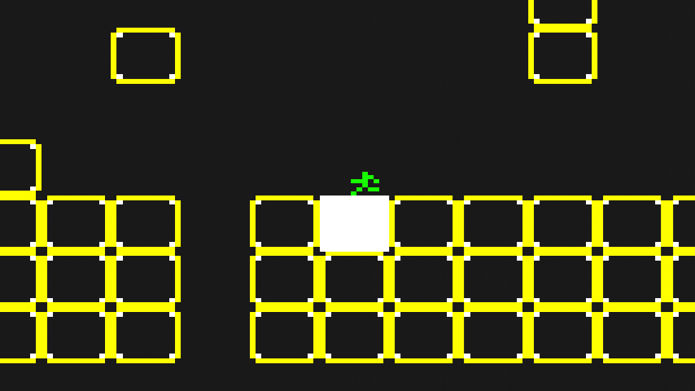
Sample Screenshots
Bob running left

Slide 22
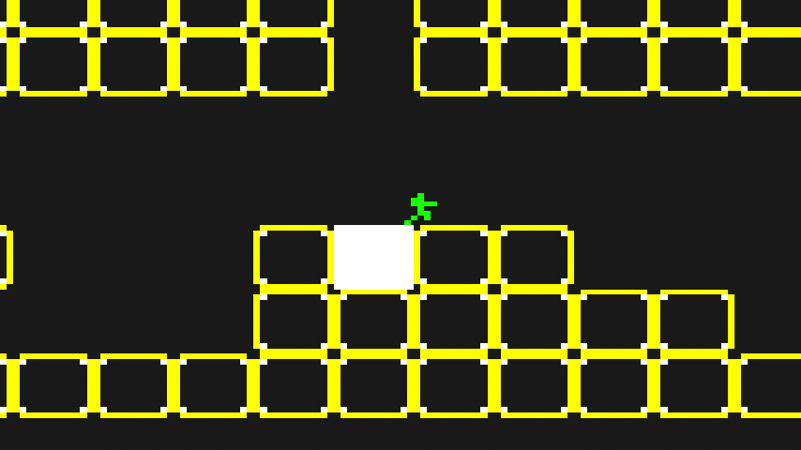
Sample Screenshots
Bob running right

Slide 23
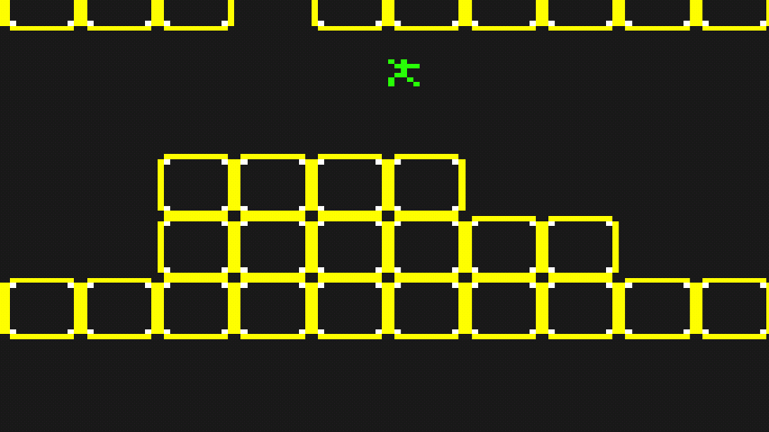
Sample Screenshots
Bob jumping

Slide 24
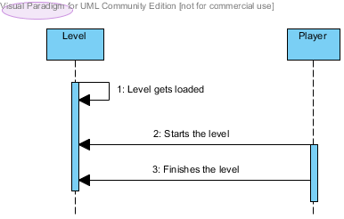
Sequence Diagram
Basic Game Behavior

Slide 25
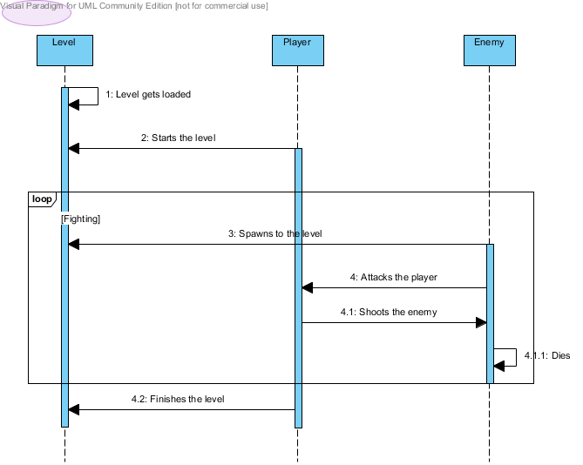
Sequence Diagram
Detailed Game Behaviour

Slide 26
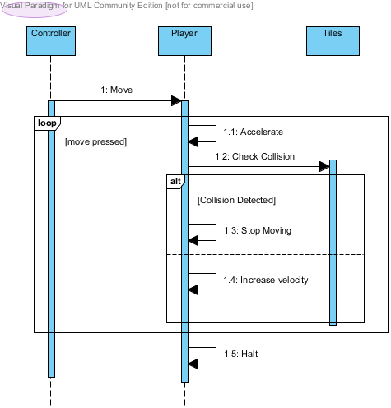
Sequence Diagram
Move player

Slide 27
IMPLEMENTATION

Slide 28
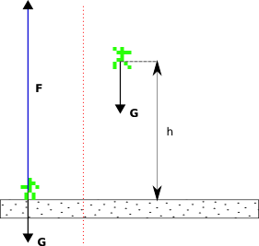
Jumping - The Physics

Slide 29
COLLISION DETECTION

Slide 30
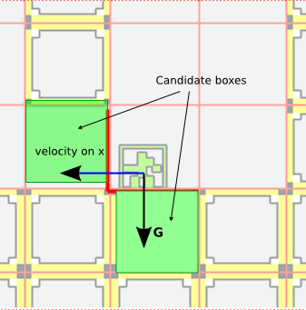
Collision Candidates

Slide 31
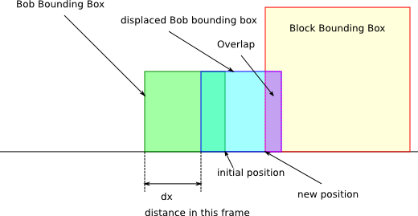
Detecting Collision

Slide 32
Future Scope
Multiple levels
Obstacles
Monsters
Scoring system
Gun stores
Sound effects

Slide 33
THANK YOU

